Slide 1
Guttula Venkata Siva Sai Lakshmi
FINAL PROJECT
3/21/2024 Annual Review

Slide 2
PROJECT TITLE
KEY LOGGERS
AND SECURITY
3/21/2024 Annual Review

Slide 3

AGENDA
Introduction
Project statement
Project overview
Who are the end users
Solution and value proportion
The “wow” in our solution
Modelling
Results
Conclusion and Q&A
3/21/2024 Annual Review

Slide 4
Introduction
keyloggers, also known as “keystroke loggers” These tools record every keystroke a person types on a device, often without their awareness.
Keyloggers capture every keystroke entered on a computer or mobile keyboard. Since we interact with devices primarily through keyboards, keyloggers can track a wealth of information, including credit card details, visited websites, and passwords
They are often used without the user’s knowledge and can capture sensitive data like login credentials and credit card numbers.
Awareness and security measures are crucial to protect against keylogger threats

Slide 5

PROBLEM STATEMENT
Keyloggers are a significant threat to cybersecurity, leading to unauthorized access to sensitive information , identity theft, and financial fraud.
Affects individuals, businesses, and organizations by compromising data privacy and security
3/21/2024 Annual Review

Slide 6
PROJECT OVERVIEW
Develop a comprehensive understanding of keyloggers, their type , how to work , and effective security measures to prevent keylogging attacks.
Scope:
Development Phase:
Design and implement a basic keylogger using programming languages and libraries.
Testing Phase:
Test the keylogger in a controlled environment to evaluate its functionality.
Analysis Phase:
Analyze the captured data to understand the keylogger’s effectiveness.

Slide 7
WHO ARE THE END USERS?
End users are the individuals within an organization who interact with various digital platforms, applications, and devices daily. They are often the first line of defense against cyber threats

Slide 8

YOUR SOLUTION AND ITS VALUE PROPOSITION
Creation for Educational and Defensive Purposes:
Purpose: An ethical keylogger is designed to be used as a tool for educational and defensive cybersecurity purposes.
Educational Use:Demonstrates how keyloggers operate, providing insights into their mechanisms and behaviors.
Defensive Use:Assists in developing robust security measures by understanding potential vulnerabilities exploited by malicious keyloggers.
Defensive Strategies:
Building Resilience:Helps in creating more resilient security systems by knowing the tactics and techniques used by attackers.
Enhanced Detection:Contributes to the development of advanced detection tools and methods to identify and neutralize keyloggers.

Slide 9

THE WOW IN YOUR SOLUTION
Innovative Approach:Combining technical measures with user education for comprehensive protection.
Demonstration: Real-time demonstration of a simple keylogger to illustrate the threat and the effectiveness of security measures.
Impact: Significant reduction in the likelihood of keylogging attacks through proactive measures
3/21/2024 Annual Review
9

Slide 10
MODELLING
Teams cam add wireframes
Installing Required Libraries
Before we begin, we need to install a particular library, which we can do with the pip command: pip install pynput and pip install jsonlib.
Importing Required Libraries
pynput: This will help us read the keystrokes as the user types in stuff
JSON is a lightweight data-interchange format. It is often used for exchanging data between a web server and user agent
3/21/2024 Annual Review
10

Slide 11
Initialization: Set up the main GUI window. Initialize global variables for key logging. Event Capture: Start capturing key events when the "Start" button is pressed. Log key press and release events. Data Logging: Continuously update text and JSON log files with captured key events. Stop Logging: Stop capturing key events when the "Stop" button is pressed. Update the GUI status to indicate the keylogger is stopped.

Slide 12
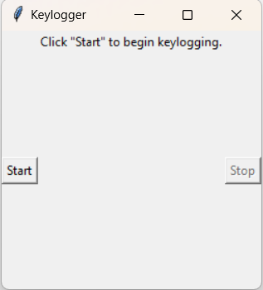
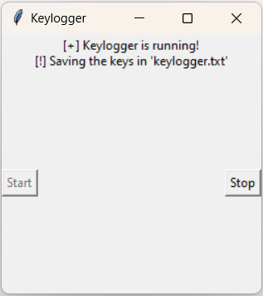
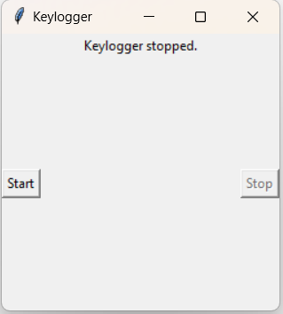
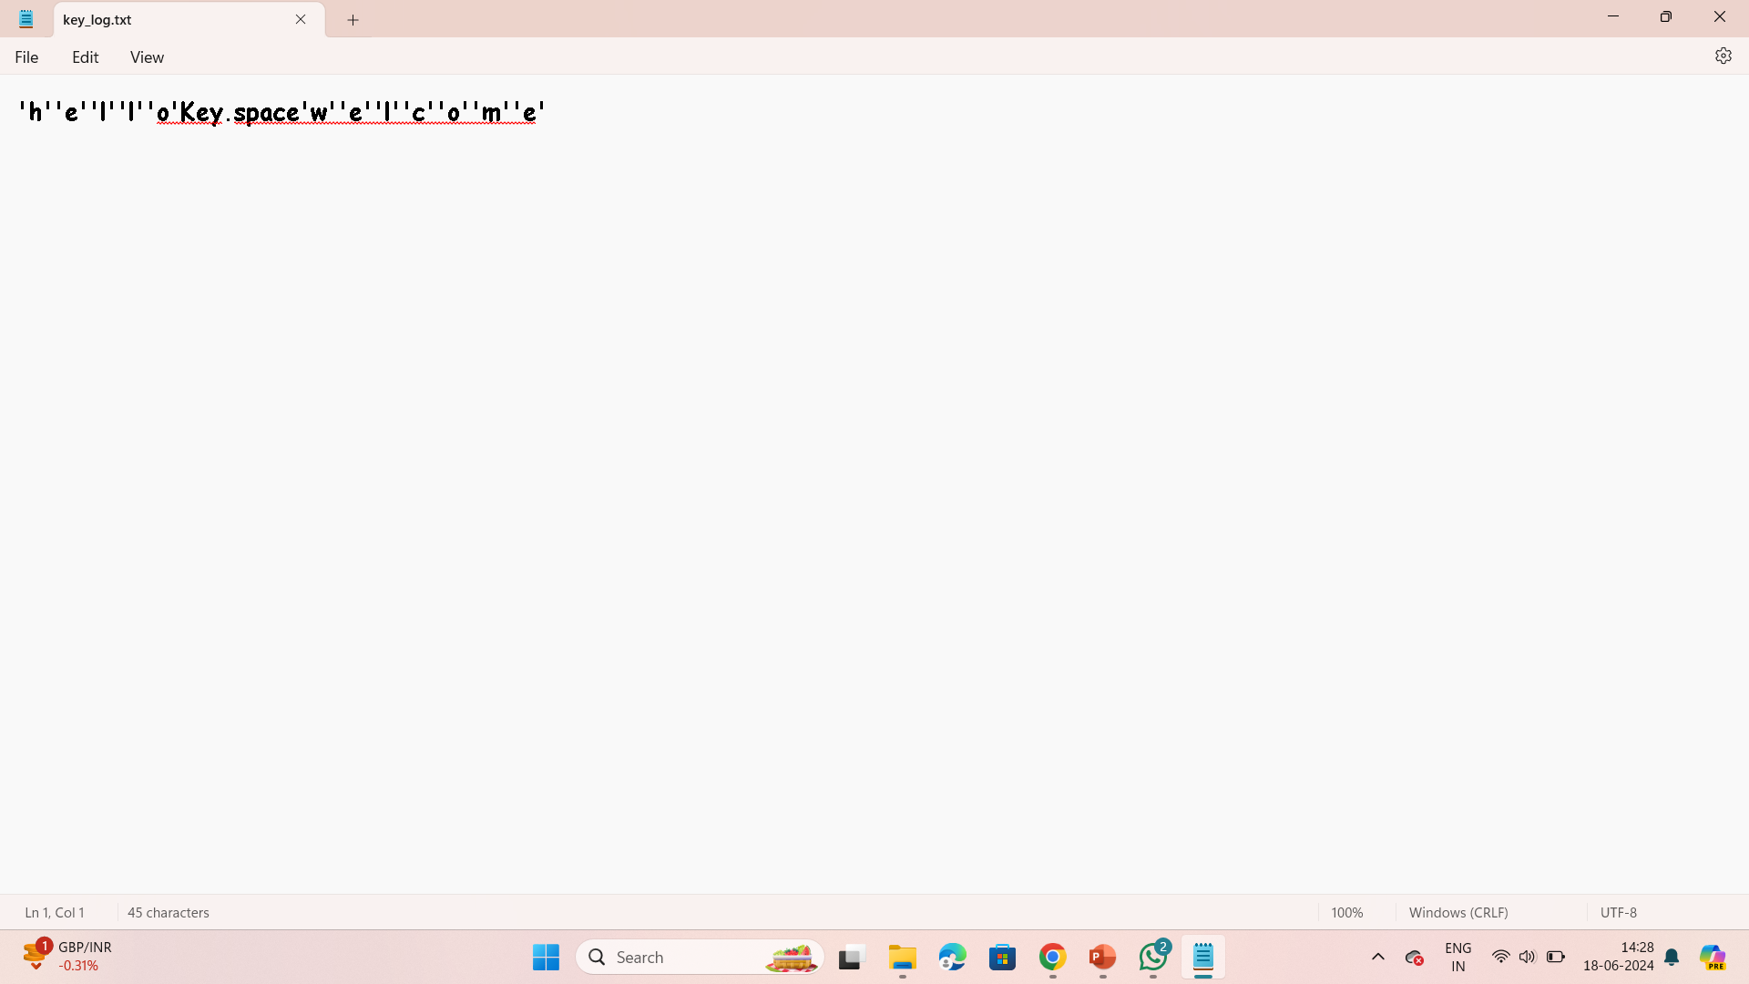
Images
3/21/2024 Annual Review
12

Slide 13
Result
The implementation of keylogger that captures keystrokes and records them into both text and JSON files is successful.
The GUI provided a user-friendly way to control the keylogger, making it accessible and easy to use.
The keylogger project demonstrated the capability to effectively capture and log keystrokes in real-time.
Emphasized the ethical use of keyloggers and the importance of implementing security measures to protect against malicious use.
Real-time keylogging with start and stop functionality controlled via a simple GUI

Slide 14
GIT HUB LINK:
https://github.com/GuttulaSaiLakshmi/cybersecurity.git

